Slide 1
PYTHON
PROGRAMMING
INTERNSHIP
BY NAMITHA RAMESH

Slide 2
TABLE OF CONTENTS
01
02
FUNCTIONS AND MODULES
DATA MANIPULATION

Slide 3
01
FUNCTIONS AND MODULES

Slide 4
PYTHON-FUNTIONS
A function is a block of organized, reusable code that is used to perform a single, related action. ​

Slide 5
TYPES OF FUNCTIONS
Built-in functions​
User-defined functions​
Functions defined in modules​

Slide 6
1. Built-in Functions​ ​ Python's standard library includes number of built-in functions. Some of Python's built-in functions are print(), int(), len(), sum(), etc. These functions are always available, as they are loaded into computer's memory as soon as you start Python interpreter.​ ​ 2. Functions defined in built-in modules​ Python - Modules​ The standard library also bundles a number of modules. Each module defines a group of functions. These functions are not readily available. You need to import them into the memory from their respective modules.

Slide 7
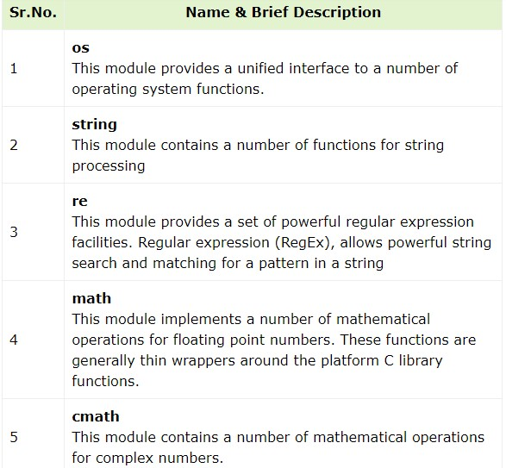
Built-in Modules​
​They are called built-in modules. Most of these built-in modules are written in C (as the reference implementation of Python is in C), and pre-compiled into the library. These modules pack useful functionality like system-specific OS management, disk IO, networking, etc.​Here are few built-in modules −​

Slide 8
User Defined Modules​
Any text file with .py extension and containing Python code is basically a module. It can contain definitions of one or more functions, variables, constants as well as classes. Any Python object from a module can be made available to interpreter session or another Python script by import statement. A module can also include runnable code.​
​
Create a Module -​
Creating a module is nothing but saving a Python code with the help of any editor. Let us save the following code as mymodule.py​
​
def SayHello(name):​
print ("Hi {}! How are you?".format(name)) ​
Return​
​
You can now import mymodule in the current Python terminal.​
​>>> import mymodule ​
>>> mymodule.SayHello("Harish")​
​
Output-​
Hi Harish! How are you?

Slide 9
3. User-defined Functions​
​ You can define custom functions to provide the required functionality.​
​ Syntax:​
def function_name (parameters):​
#statement​
return expression​
​
​Creating function -
We can create a user-defined function in Python, using the def keyword. We can add any type of functionalities and properties to it as we require.
Example:
# A simple Python function ​
​def fun():​
print("Welcome")​

Slide 10
​Calling a Python Function - ​
​
After creating a function in Python we can call it by using the name of the function followed by parenthesis containing parameters of that particular function.
Example:
# A simple Python function​
def fun():​
print("Welcome")​
​# Driver code to call a function​
fun()
​
Output-​
Welcome

Slide 11
02
DATA MANIPULATION

Slide 12
Data Manipulation in Python
Data manipulation in Python involves working with data to perform various tasks such as cleaning, transforming, aggregating, and analyzing it. Python provides several libraries and tools that make data manipulation efficient and convenient. Here are some common libraries and techniques for data manipulation in Python:
1. NumPy: NumPy is a fundamental library for numerical operations in Python. It provides support for arrays and matrices, which are essential for data manipulation tasks.
Example:
import numpy as np
# Create a NumPy array
data = np.array([1, 2, 3, 4, 5])
# Perform operations on the array
mean = np.mean(data)

Slide 13
3. Pandas: Pandas is a powerful library for data manipulation and analysis. It provides data structures like DataFrames and Series, which allow you to work with tabular data effectively.
Example:
import pandas as pd
# Create a DataFrame from a dictionary
data = pd.DataFrame({'A': [1, 2, 3], 'B': [4, 5, 6]})
# Select a column
column_A = data['A']
# Filter rows based on a condition
filtered_data = data[data['B'] > 4]
3. Matplotlib and Seaborn: These libraries are used for data visualization, which is often an important part of data manipulation to gain insights from data.
Example:
import matplotlib.pyplot as plt
import seaborn as sns
# Create a scatter plot
sns.scatterplot(x='A', y='B', data=data)
plt.show()

Slide 14
6. Aggregation: You can use functions like groupby in Pandas to group data and perform aggregation operations. Example: # Grouping and aggregating data in Pandas grouped_data = data.groupby('Category')['Value'].sum() 7. List Comprehensions: For simple data manipulations, list comprehensions can be used to create new lists or transform existing ones. Example: # Using list comprehensions to transform data squared_numbers = [x**2 for x in data] 8. Regular expressions: Python’s ‘re’ module allows you to work with text data and perform pattern-based data manipulation. Example: import re # Extracting data using regular expressions pattern = r'\d{3}-\d{2}-\d{4}' matches = re.findall(pattern, text)

Slide 15
4. NumPy and Pandas for Data Cleaning: You can use these libraries to handle missing data, remove duplicates, and perform other data cleaning tasks. Example: # Handling missing values in Pandas data.dropna() # Remove rows with missing values data.fillna(value) # Fill missing values with a specific value 5. NumPy and Pandas for Data Transformation: You can manipulate data by performing operations like sorting, merging, and reshaping. Example: # Sorting data in Pandas sorted_data = data.sort_values(by='A') # Merging DataFrames in Pandas merged_data = pd.concat([df1, df2], axis=1) # Reshaping data in Pandas pivoted_data = data.pivot(index='A', columns='B', values='C')

Slide 16
THANK YOU

